Slide 1
TLS
Freshman Seminar
2022.03.04
Sumin Sohn

Slide 2
Contents
17.1 Web security considerations
17.2 Secure socket layer(SSL)
17.3 Transport layer security(TLS)
17.4 HTTPS
TLS 1.3

Slide 3
17.1 Web Security Considerations

Slide 4
Web Security Threats: Classification
Passive attacks
Eavesdropping on network traffic between browser and server
Gaining access to information on a web site that is restricted
Active attacks
Impersonating another user
Alternating messages in transit between client and server
Alternating data on web
Can be also classified by terms of location of the threat
Web server, web browser, network traffic between browser and server
Notes:
Network traffic security가 이 챕터에서 다룰 부분

Slide 5
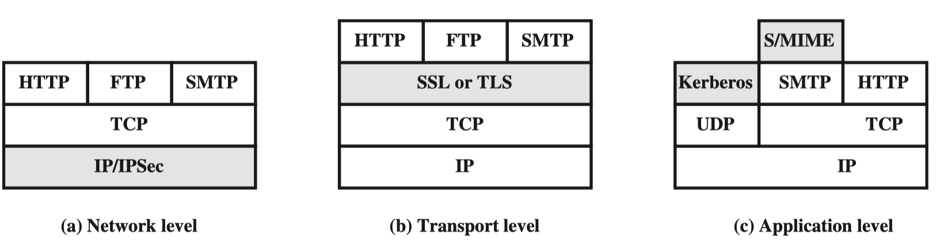
Web Traffic Security Approaches #1
Protections are similar in service, but differ in:
Scope of Applicability
Relative location within the TCP/IP protocol stack
Network level – IPsec
Transparent to end users and applications
Provides general-purpose solution
Filtering capability included
Only selected packet gets IPsec processing
Notes:
General-purpose solution: 어디에나 휘뚜루 마뚜루 쓸 수 있는 솔루션이다

Slide 6
Web Traffic Security Approaches #2
Transport level – SSL/TLS
Implemented just over TCP
Two implementation approaches:
Provided as part of protocol suite, transparent to applications
Embedded in specific packages
Application level
Embedded within particular app
Can be tailored to the specific need of app
Notes:
Protocol suite = set of protocols
TCP의 일부로서 들어와 있어서 특별한 패키지나 구현없이 사용 가능하다는 걸 뜻함

Slide 7
17.2 Secure Socket Layer(SSL)

Slide 8
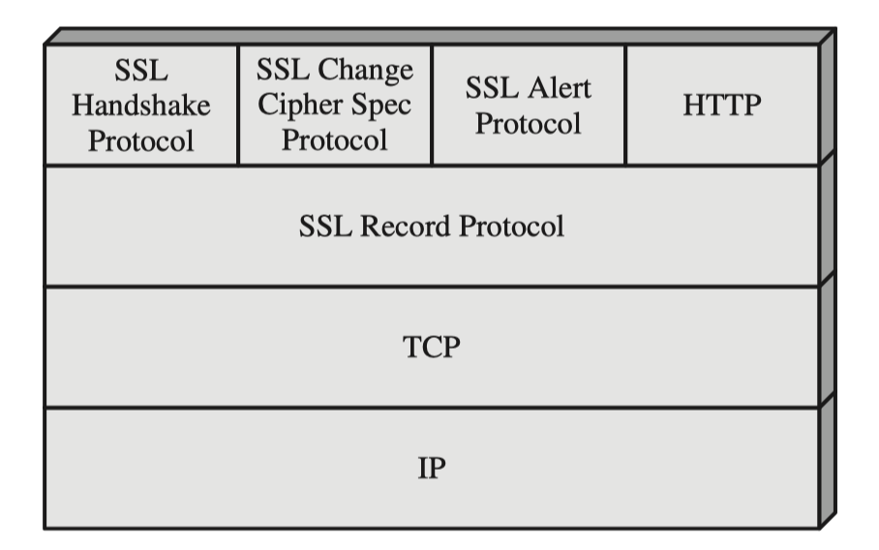
SSL Architecture
SSL is designed to make use of TCP to provide reliable end-to-end secure service
SSL is not a single protocol but rather two layers of protocols
SSL record protocol
Provides basic security services to various higher layer protocols
E.g., HTTP
Three higher-layer protocols
Handshake protocol
Change cipher spec protocol
Alert protocol
Notes:
Higher layer protocol은 SSL exchange를 관리하는데 사용됨

Slide 9
SSL Connection and Session
Connection
A single transmission
Peer-to-peer relationships that is transient
Every connection is associated with one session
Session
Association between client and server
Created by handshake protocol
Session defines set of cryptographic security parameters that can be shared among multiple connections
Sessions are used to avoid expensive renegotiation for each new connection
For single session, there may be multiple connections
Notes:
Transient 일시적인

Slide 10
SSL Session Parameters #1
Session identifier
Arbitrary byte sequence chosen by server
Peer certificate
X509.v3 certificate of peer
Compression method
Used to compress data prior to encryption
Cipher spec
Specify data encryption algorithm, hash algorithm, and cryptographic attributes
Notes:
Resumble

Slide 11
SSL Session Parameters #2
Master secret
48-byte shared secret between client and server
Is resumable
Flag indicating whether session can be used to initiate new connection
Notes:
Resumble

Slide 12
SSL Connection Parameters #1
Server and client random
Byte sequences chosen by server and client for each connection
Server write MAC secret
Secret key used in MAC operation by server
Client write MAC secret
Secret key used in MAC operation by client
Server write key
Secret key for encryption used by server
Client write key
Secret key for encryption used by client

Slide 13
SSL Connection Parameters #2
Initialization vector
When block cipher in CBC mode is used, IV is maintained for each key
Initialized by SSL handshake protocol
Sequence numbers
Each party maintains transmitted and received sequence numbers for each connection

Slide 14
SSL Record Protocol: Two Providing Services
Confidentiality
Symmetric encryption of SSL Payloads
Message integrity
Form message authentication code(MAC)
Notes:
SSL record protocol은 데이터 교환을 위한 프로토콜

Slide 15
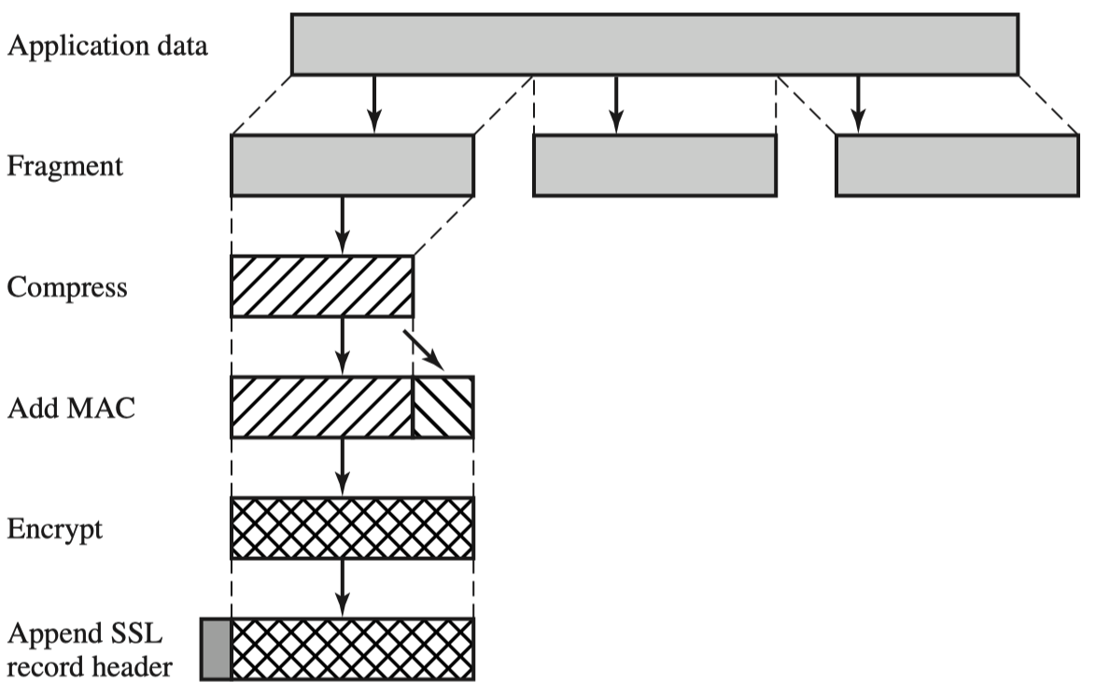
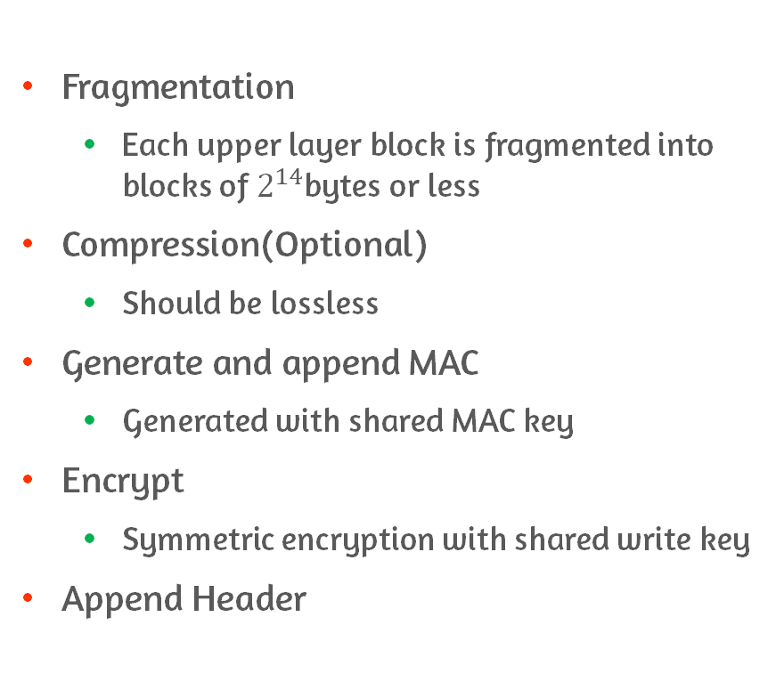
SSL Record Protocol: Procedure
Fragmentation
Each upper layer block is fragmented into blocks of $2^{14}$bytes or less
Compression(Optional)
Should be lossless
Generate and append MAC
Generated with shared MAC key
Encrypt
Symmetric encryption with shared write key
Append Header

Slide 16
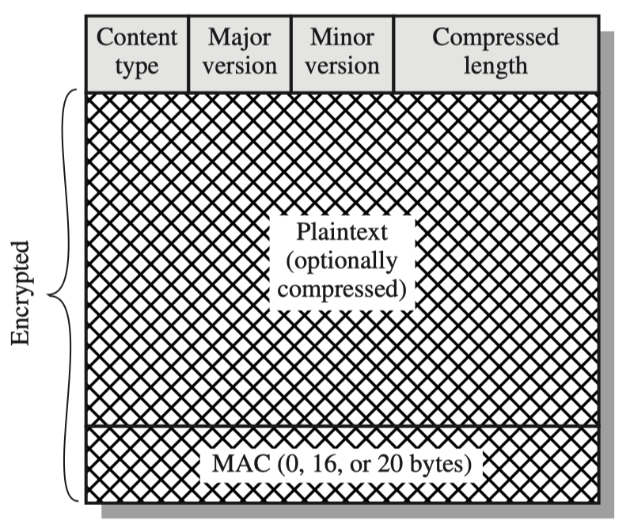
SSL Record Protocol: Header
Content Type (8 bits)
Higher-layer protocol used to process fragment
change_cipher_spec, alert, handshake, application_data
Major Version (8 bits)
Indicates major version of SSL
For SSLv3 the value is 3
Minor Version (8 bits)
Indicates minor version of SSL
For SSLv3 the value is 0
Compressed Length (16 bits)
Length of plaintext or compressed fragment
SSL Record Format

Slide 17
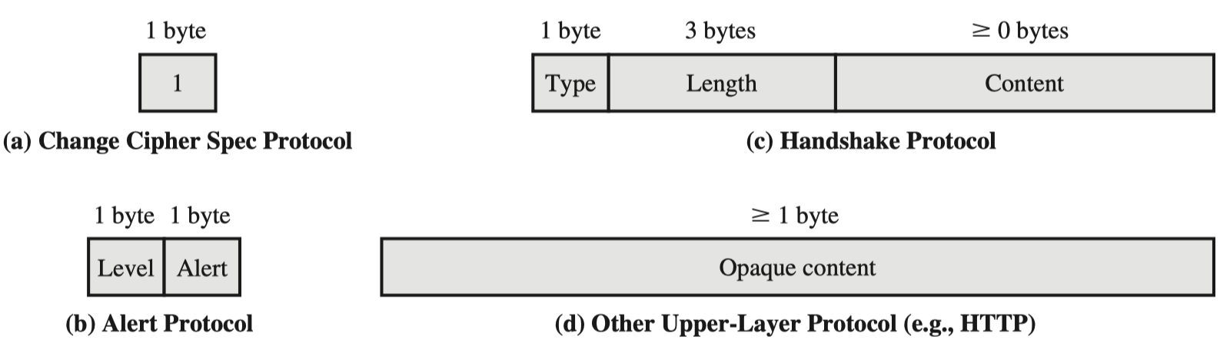
SSL Upper Layer Protocols
Change cipher spec protocol
Alert protocol
Handshake protocol
Other upper-layer protocols
HTTP

Slide 18
Change Cipher Spec Protocol
Protocol consists of single message
Single byte with value 1
Purpose: update cipher suite to be used on following connection
Declare that just negotiated cipher spec and keys will be used for all the messages exchanged henceforth
Notes:
이번 connection에 사용할 cipher suite를 업데이트 하는 역할
막 negotiate한 cipher spec이랑 key를 앞으로 교환하는 모든 메시지에서 사용한다는 걸 선언하는 역할

Slide 19
Alert Protocol
Used to convey SSL-related alerts to peer entity
Alert messages are compressed and encrypted by current state
Message consists of two bytes
Level of severity – warning / fatal
If fatal, SSL terminates connection and no new connections established for same session
Code of specific alert
Notes:
Convey; 전달하다

Slide 20
Handshake Protocol
Handshake protocol is used before any application data is transmitted
Series of messages exchanged between server and client
Purpose
Server and client authenticate each other
Negotiate encryption and MAC algorithm
Negotiate cryptographic keys

Slide 21
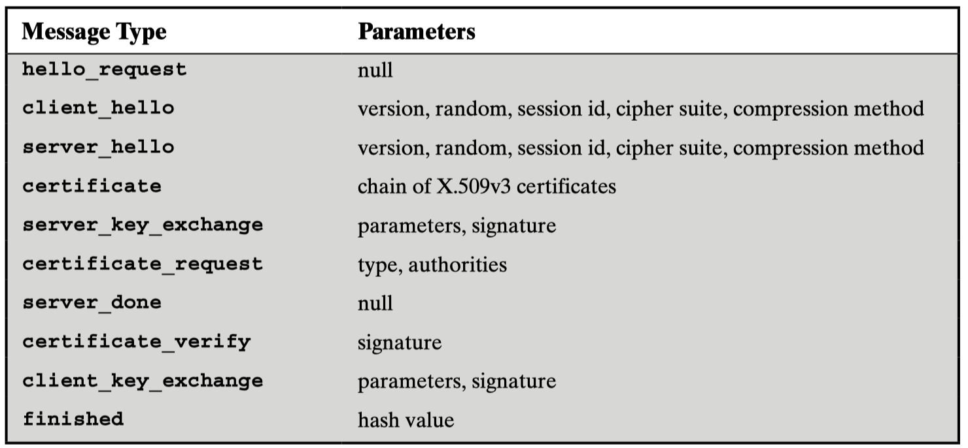
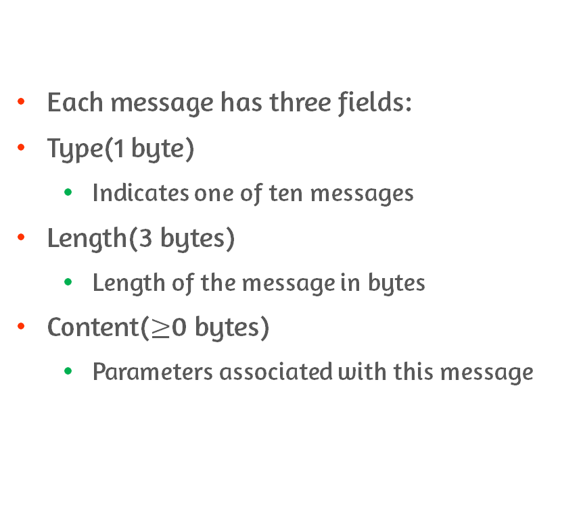
Handshake Protocol: Message Format
Each message has three fields:
Type(1 byte)
Indicates one of ten messages
Length(3 bytes)
Length of the message in bytes
Content($≥$0 bytes)
Parameters associated with this message

Slide 22
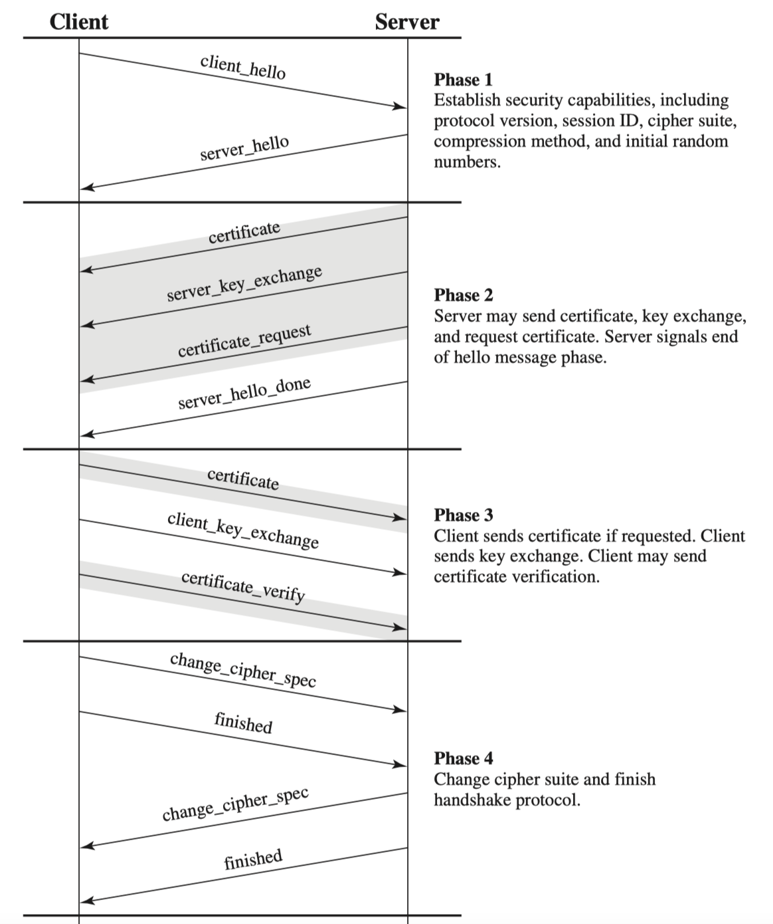
Handshake Procedure
Phase 1
Establish security capabilities
Phase 2
Server authentication and key exchange
Phase 3
Client authentication and key exchange
Phase 4
Finish

Slide 23
Phase 1: Establish Security Capabilities #1
Performed to initiate logical connection and to establish security capabilities
Initiated by client with client_hello message
Version: highest SSL version supported by client
Random: client-generated random value which serves as nonces to prevent replay attack
Session ID: variable length session identifier
Nonzero value: indicates that client wants to update parameters of an existing connection or to create new connection on this session
Zero value: client wants to create new connection on a new session
CipherSuite: list of cryptographic algorithms that client supports
Each element defines both key exchange algorithm and CipherSpec
Compression Method: list of compression methods that client supports

Slide 24
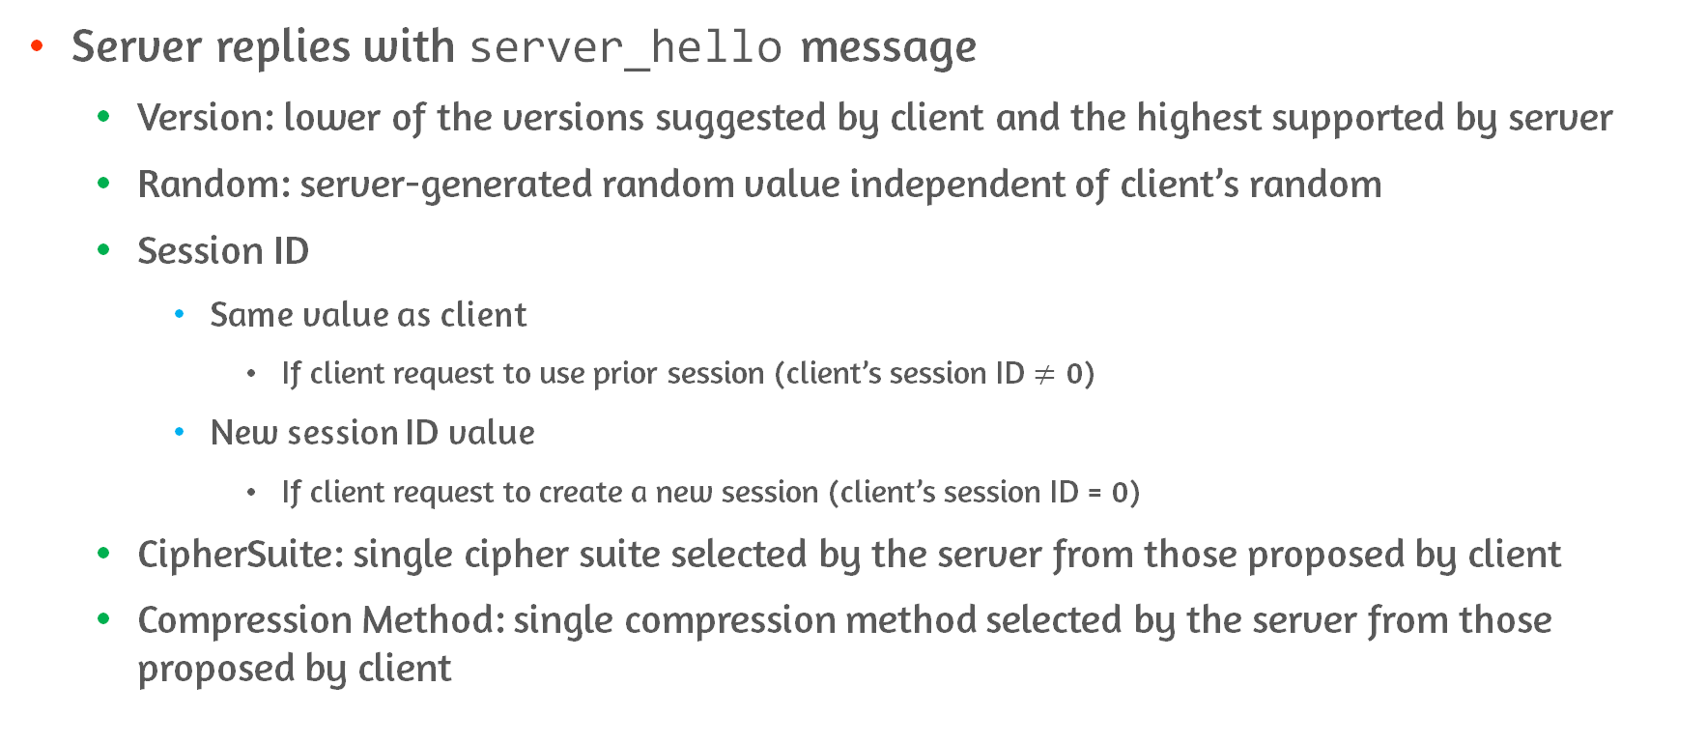
Phase 1: Establish Security Capabilities #2
Server replies with server_hello message
Version: lower of the versions suggested by client and the highest supported by server
Random: server-generated random value independent of client’s random
Session ID
Same value as client
If client request to use prior session (client’s session ID $≠$ 0)
New session ID value
If client request to create a new session (client’s session ID = 0)
CipherSuite: single cipher suite selected by the server from those proposed by client
Compression Method: single compression method selected by the server from those proposed by client

Slide 25
CipherSuite Parameters: Key Exchange Methods
RSA
Encrypt secret key with receiver’s RSA public key from certificate
Fixed Diffie-Hellman
Public key parameters signed and included in certificate
Resulting in fixed shared secret key
Ephemeral Diffie-Hellman
To create ephemeral secret key
Ephemeral public keys are exchanged, signed, using sender’s private key
Anonymous Diffie-Hellman
Exchange Diffie-Hellman parameters with no authentication
Notes:
RSA랑 Ephemeral, anonymous

Slide 26
Phase 2: Server Authentication and Key Exchange #1
Server begins this phase by sending server_certificate message for authentication
Required except anonymous Diffie-Hellman
Server sends server_key_exchange message if required
Instances not required
Fixed DH: public key parameters already included in certificate
RSA key exchange: simply send secret key encrypted with public key from server’s certificate
Instances required
Anonymous Diffie-Hellman
Ephemeral Diffie-Hellman
RSA key exchange(If server is using signature-only RSA key)
Notes:
Server certificate message에는 X.509 인증서가 들어있음
서명 검증용 키는 인증서에 들어있음 – 이건 검증용
Key exchange 때 temporary key를 만들어서 보내고
- 이에 대한 검증용으로 사용함

Slide 27
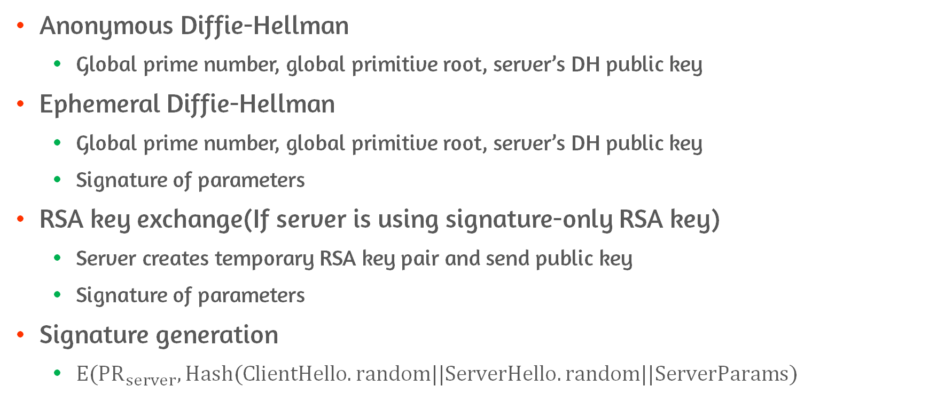
server_key_exchange Message Params
Anonymous Diffie-Hellman
Global prime number, global primitive root, server’s DH public key
Ephemeral Diffie-Hellman
Global prime number, global primitive root, server’s DH public key
Signature of parameters
RSA key exchange(If server is using signature-only RSA key)
Server creates temporary RSA key pair and send public key
Signature of parameters
Signature generation
$E({PR}_{server},Hash(ClientHello.random||ServerHello.random||ServerParams)$
Notes:
Hash가 nonce까지 같이 묶어서 돌려서 replay attack에 저항성을 가짐
- Server parameter 뿐만 아니라, random도 같이 hash한다는 점

Slide 28
Phase 2: Server Authentication and Key Exchange #2
Server not using anonymous DH can request certificate from client
Certificate_request message
Includes two fields:
certificate_type
Indicates public-key algorithm and its use
certificate_authorities
List of acceptable certificate authorities
Server finishes phase 2 with server_done message
Always required
Indicates end of server hello
Notes:
RSA , signature only로 쓸거야
RSA , fixed/ephemeral Diffie-Hellman에서 쓸거야

Slide 29
Phase 3: Client Authentication and Key Exchange #1
Upon receipt of server_done message, client should verify that
Server provided a valid certificate
server_hello parameters are acceptable
If server requested certificate, client replies with client_certificate message
If no suitable certificate is available, no_certificate alert is returned
client_key_exchange_message which is mandatory
RSA: client generates pre-master secret and encrypts with server public key from cert
Ephemeral/anonymous DH: client’s public DH parameters are sent
Fixed DH: client’s public DH parameters were already sent with client_certificate message, so message is null

Slide 30
Phase 3: Client Authentication and Key Exchange #2
Finally, in this phase client may send certificate_verify_message to provide verification of a client certificate
Only sent when client certificate has signing capability
Message signs a hash code based on preceding handshake messages
Message’s purpose is to verify client’s ownership of the private key for the client certificate
Notes:
Preceding message
– master_secret, handshake message, pad 1, pad2
RSA에서는 MD5랑 SHA-1 hash 각각 때리고 concatenate

Slide 31
Phase 4: Finish
Finish phase completes the setting up of secure connection
Client sends change_chipher_spec message
Copies pending CipherSpec into current CipherSpec
This message is considered as change cipher spec protocol
Client sends finished message
Content includes hash of master_secret and all handshake_messages up to but not including this message
Encrypted with negotiated algorithm, keys, and secret
Verify key exchange and authentication process
Server replies with change_chipher_spec and finished message
At this point, handshake is complete and application data could be sent
Notes:
Finish 메시지는 암호화 되어 있음 by record protocol
(Chane cipher spec에서 cipher spec 옮겨놨으니까)

Slide 32
Cryptographic Computations
Creation of a shared master secret key
Generation of cryptographic parameters from the master secret
Client write MAC secret
Server write MAC secret
Client write key
Server write key
Client write IV
Server write IV

Slide 33
Master Secret Creation
Shared master secret is one-time 48-byte(384 bits) value generated for this session by means of key exchange
Creation is in two stages:
pre_master_secret(pms) is exchanged
RSA
pms is generated by client , encrypted with server’s public key and sent to server
Server decrypts it with private key and recover pms
Diffie-Hellman
Both client and server generate DH public key and exchanges
Each side performs DH calculation to create PMS
Both side compute master_secret

Slide 34
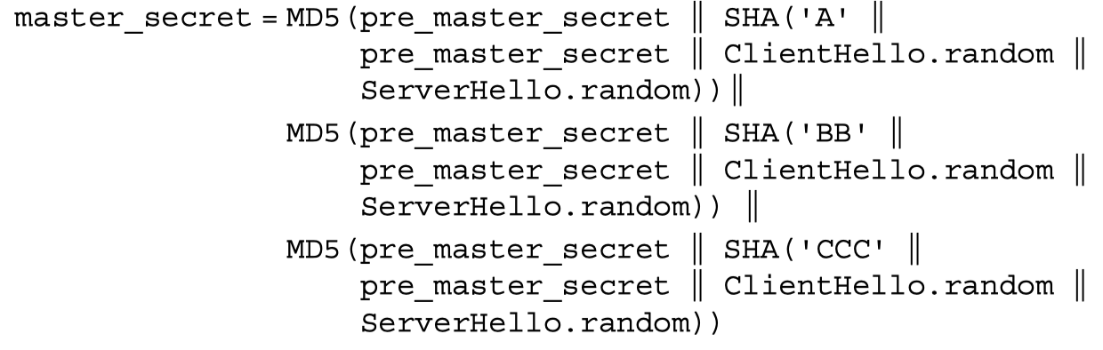
Calculation of master_secret
Notes:
이렇게 premaster secret과 hello에서의 random을 넣고 계산한다

Slide 35
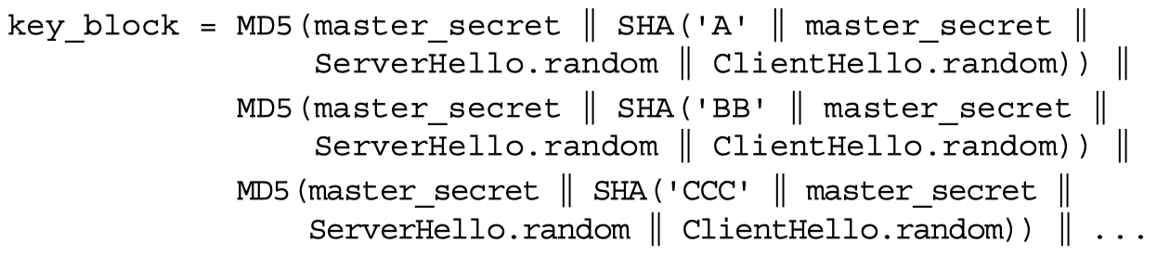
Generation of Cryptographic Parameters
Server write MAC secret, Client write key, Server write key, Client write IV, Server write IV are generated by hashing master_secret
Hashing is repeated in following manner until enough output is generated
Master_secret serves as pseudorandom seed value to the function
Client/server random values are used as salts

Slide 36
17.3 Transport Layer Security(TLS)

Slide 37
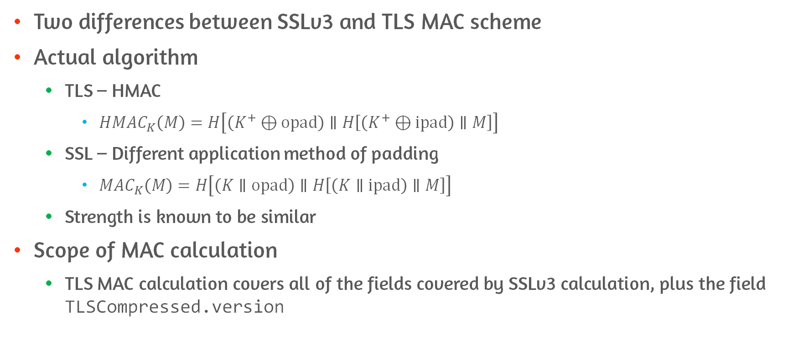
Message Authentication Code
Two differences between SSLv3 and TLS MAC scheme
Actual algorithm
TLS – HMAC
$HMAC_{K}\left(M\right)=H\left[\left(K^{+}⊕opad\right)∥H\left[\left(K^{+}⊕ipad\right)∥M\right]\right]$
SSL – Different application method of padding
$MAC_{K}\left(M\right)=H\left[\left(K∥opad\right)∥H\left[\left(K∥ipad\right)∥M\right]\right]$
Strength is known to be similar
Scope of MAC calculation
TLS MAC calculation covers all of the fields covered by SSLv3 calculation, plus the field TLSCompressed.version
Notes:
MAC secret key로 MAC 계싼
Sequence number, TLS compressed version, length, fragment

Slide 38
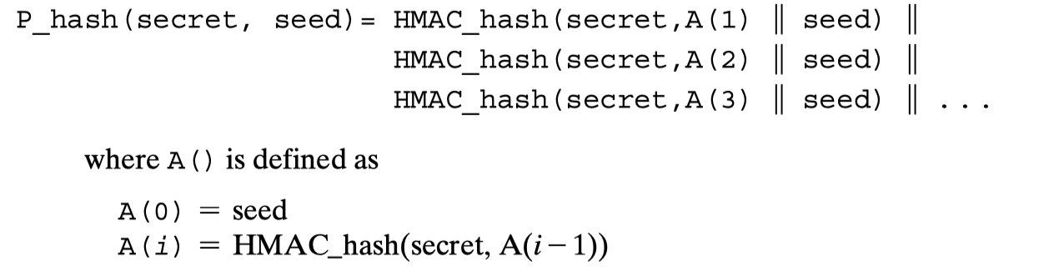
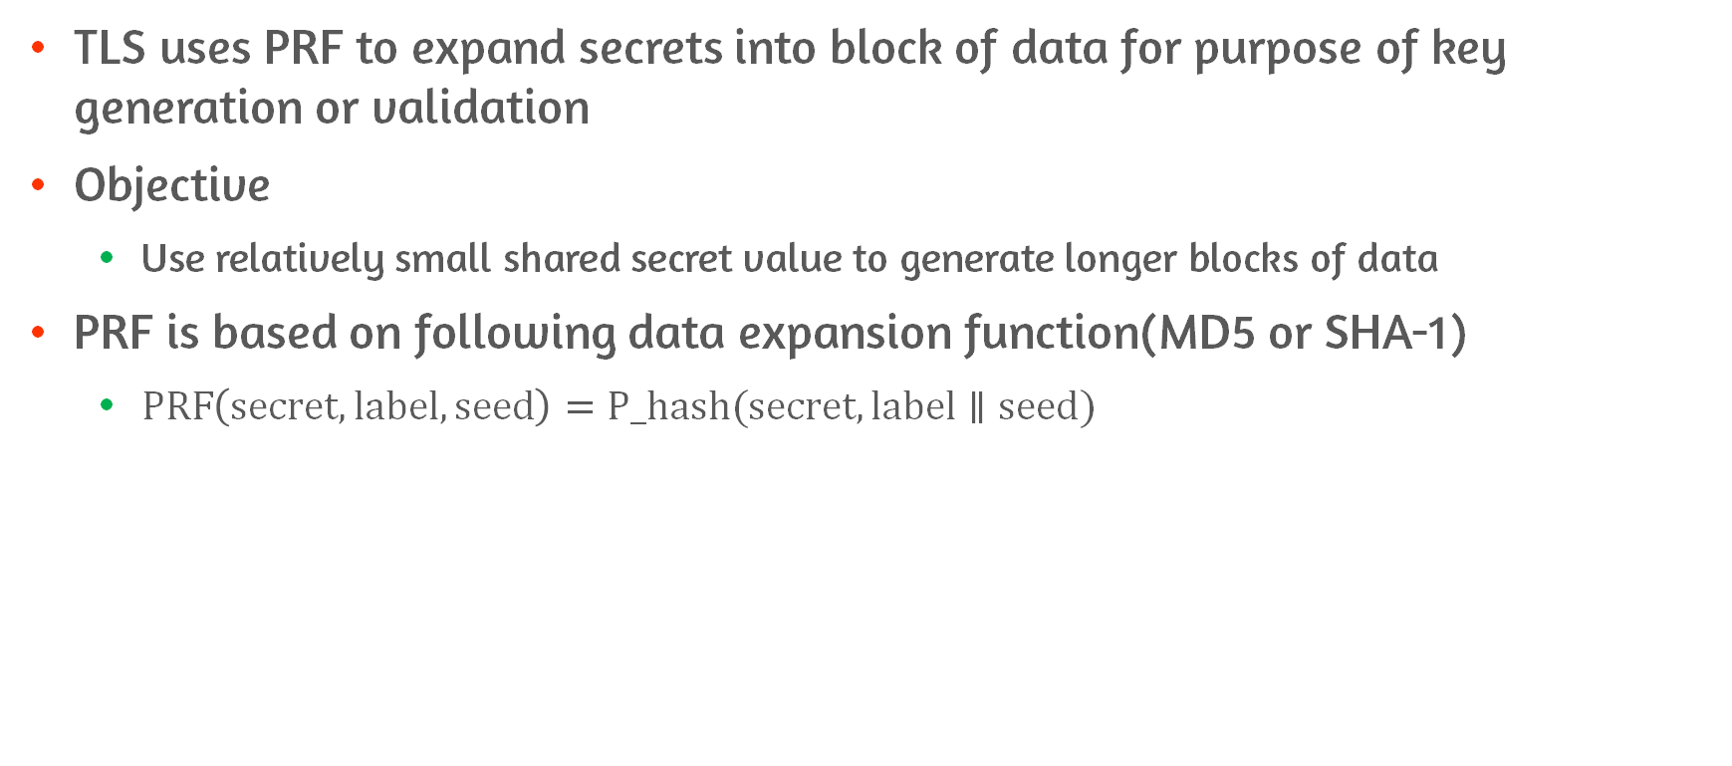
Pseudorandom Function
TLS uses PRF to expand secrets into block of data for purpose of key generation or validation
Objective
Use relatively small shared secret value to generate longer blocks of data
PRF is based on following data expansion function(MD5 or SHA-1)
$PRF\left(secret, label, seed\right)=P_hash(secret, label∥seed)$

Slide 39
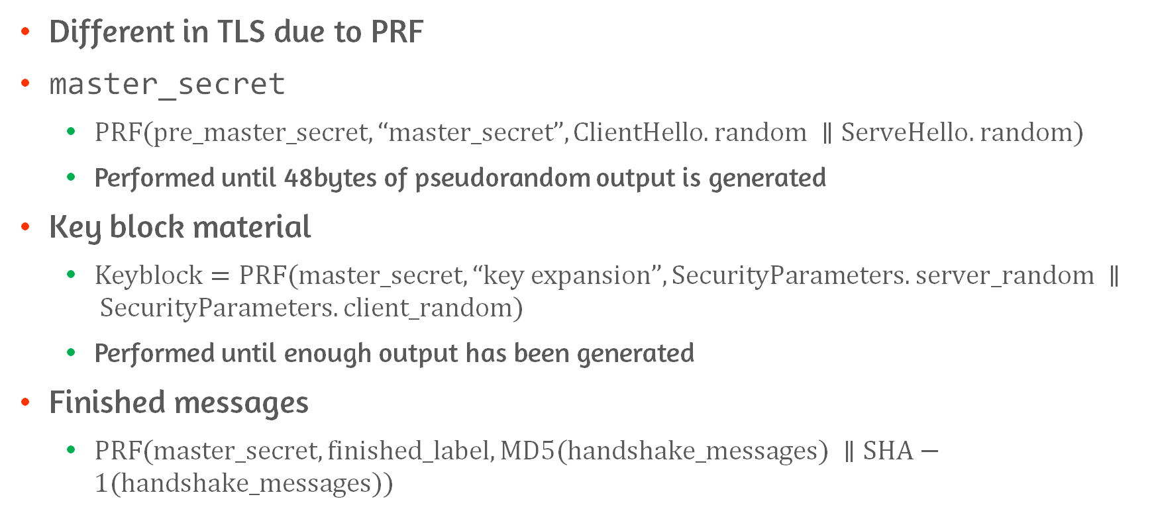
Cryptographic Computations
Different in TLS due to PRF
master_secret
$PRF(pre_master_secret, “master_secret”, ClientHello.random ∥ServeHello.random)$
Performed until 48bytes of pseudorandom output is generated
Key block material
$Keyblock=PRF(master_secret, “key expansion”, SecurityParameters.server_random ∥ SecurityParameters.client_random)$
Performed until enough output has been generated
Finished messages
$PRF(master_secret, finished_label, MD5(handshake_messages) ∥SHA−1(handshake_messages))$
Notes:
Ssl은 같은 parameter를 hash에 넣는 방식
- MD5나 SHA에

Slide 40
Heartbeat Protocol

Slide 41
SSL/TLS Attacks
Attacks on the handshake protocol
Compromise the handshake protocol based on RSA
Attacks on the record and application data protocols
BEAST attack
relies on the predictable nature of IV in CBC mode
Attacks on PKI
Commonly used library for SSL/TLS suffer from vulnerable certificate validation
DoS attack
The attacker creates a heavy processing load
Majority of computation is on the server

Slide 42
17.4 HTTPS

Slide 43
HTTP over SSL(HTTPS)
Combination of HTTP and SSL
To implement secure communication between web browser and server
Principal difference
URL begins with https://
Connection use port 443
Encrypted elements
URL of requested document
Contents of HTTP header
Contents of document and browser forms filled by user
Cookies sent from browser and also server

Slide 44
Connection Initiation
HTTP client act as TLS client
Procedure
Client initiates connection to server on appropriate port
Client sends TLS ClinetHello to begin TLS handshake
When TLS handshake is finished, client initiate first HTTP request
All HTTP data is sent as TLS application data
Three levels of awareness
At HTTP level, HTTP client request connection to HTTP server by sending request to TLS
At TLS level, session is established between TLS client and TLS server beginning with TCP connection
At TCP level, TCP connection is established between TCP entity on client and server side

Slide 45
Connection Closure
HTTP client or server can indicate closing of connection
By HTTP record - Connection: close
Closure of HTTPS connection requires that TLS close connection
At TLS level, close connection using TLS alert protocol
Send close_notify alert
And then, close connection without waiting for peer to send its closure alert
Incomplete close to reuse session
HTTPs clients must be able to cope with unannounced TCP closure
TCP connection Is terminated without close_notify or Connection: close
Notes:
Client process가 강제 종료되면, 유령 세션이 계속해서 발생
서버에서 계속 상태 변화없이 계속 남아있어서 서버의 리소스 낭비

Slide 46
TLS 1.3

Slide 47
Features
Removes a support for a number of options and functions
Compression, Ciphers with out authenticated encryption,RC4, Renegotiation
Key exchange
Only DH or EC-DH
No RSA – provide PFS
Allow for 1-RTT handshake
By changing the order of the handshake messages

Slide 48
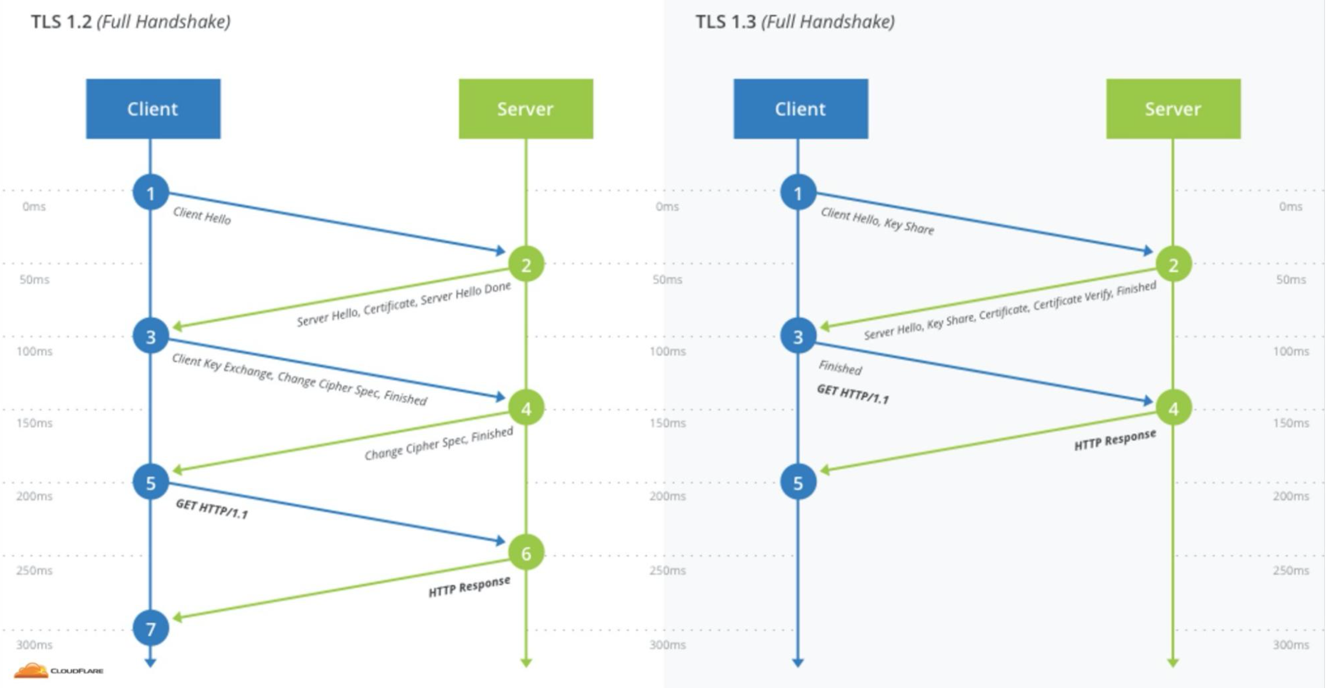
1-RTT
Round trip time is reduced by one compared to 1.2
How?
1.3 reduced cipher suite
Don’t need to wait until the server confirm shared symmetric key option
Reducing 1-RTT is critical to speed
Unlike 1.2
Client Hello includes key_share
key_share
Cryptographic Parameters for key establishment

Slide 49
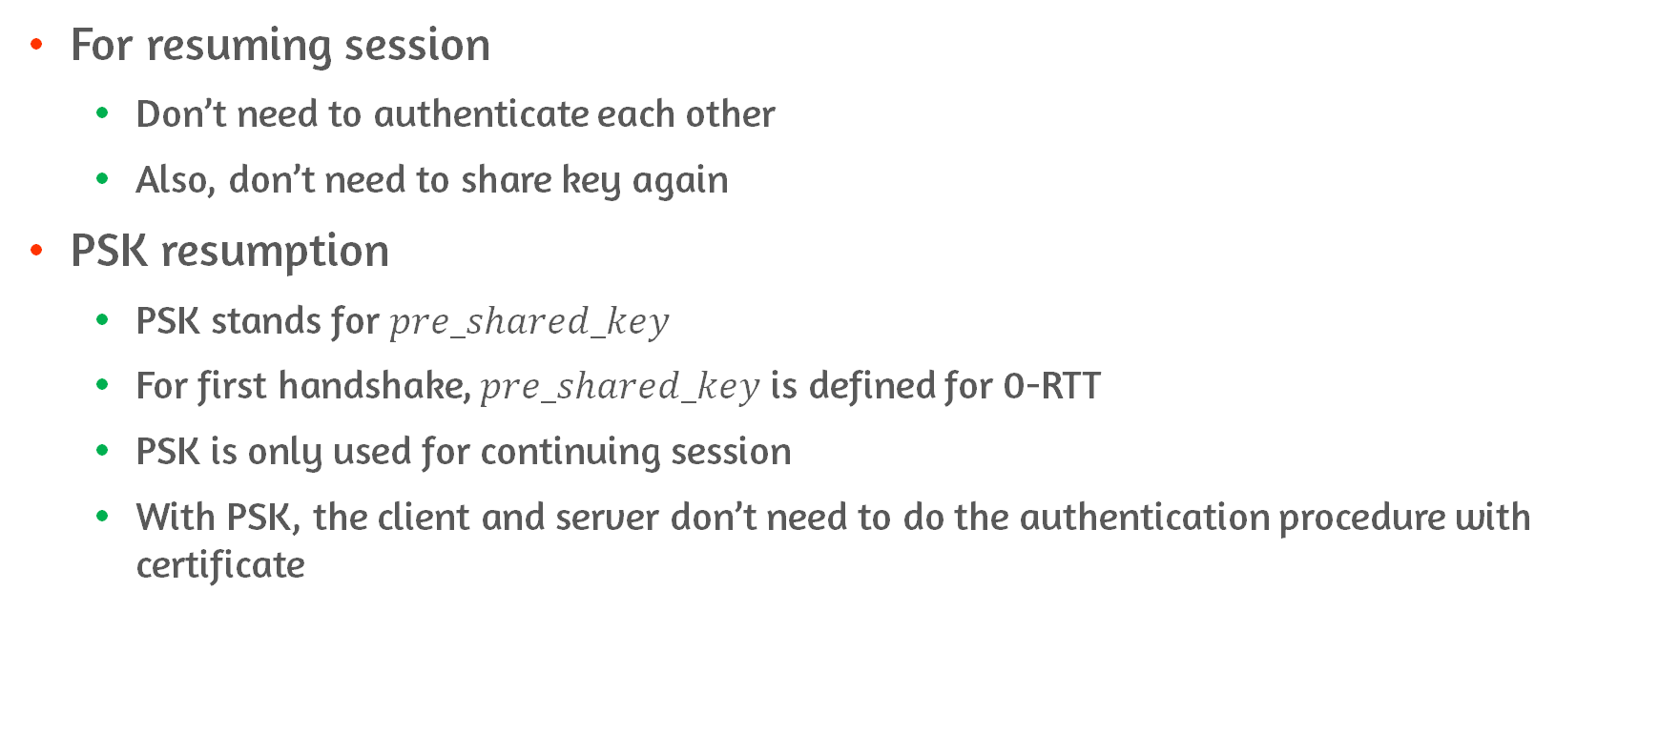
0-RTT Resumption
For resuming session
Don’t need to authenticate each other
Also, don’t need to share key again
PSK resumption
PSK stands for $pre_shared_key$
For first handshake, $pre_shared_key$ is defined for 0-RTT
PSK is only used for continuing session
With PSK, the client and server don’t need to do the authentication procedure with certificate

Slide 50
0-RTT Replay Attack
The attacker can do the replay attack if attacker can obtain 0-RTT packet
The server must be prudent before turning on 0-RTT option
Upper layer's security consideration is needed

Slide 51
Renegotiation Disabled
Negotiate the secure session over the previous encrypted session
Renegotiation can be triggered
To Update a parameter of an existing session
To Continue the session after session time expires
MITM attacker can hold the sender's packet
Lead the sender to renegotiate the session over attacker-server session
Disabled on 1.3

Slide 52
Perfect Forward Secrecy
Encryption system that changes keys frequently and automatically
Achieved by ephemeral session key share
Diffie hellman key share is representative
E.g., key ‘A’ is exposed
RSA
Massive amount of sensitive data can be exposed
DH
Only certain part of sensitive data is exposed

Slide 53
Forwards vs Backwards Secrecy
Forward secrecy
Guards against future compromises of past sessions
Backward secrecy
Self-mitigate compromises of past sessions
Main difference
Forward is preventative
Backward is mitigating

Slide 54
Double Ratchet Algorithm

Slide 55
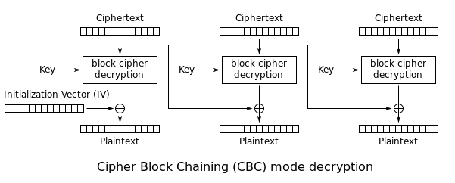
POODLE attack #1
Padding Oracle attack can be possible by downgrading TLS version
By downgrading to SSL v3.0
Solved by Disabling SSL v3.0
Attacker with the ability to modify ciphertext can extract value of the plaintext
Use of Mac-then-encrypt and CBC make this attack possible
Because of MtE, the receiver need to decrypt

Slide 56
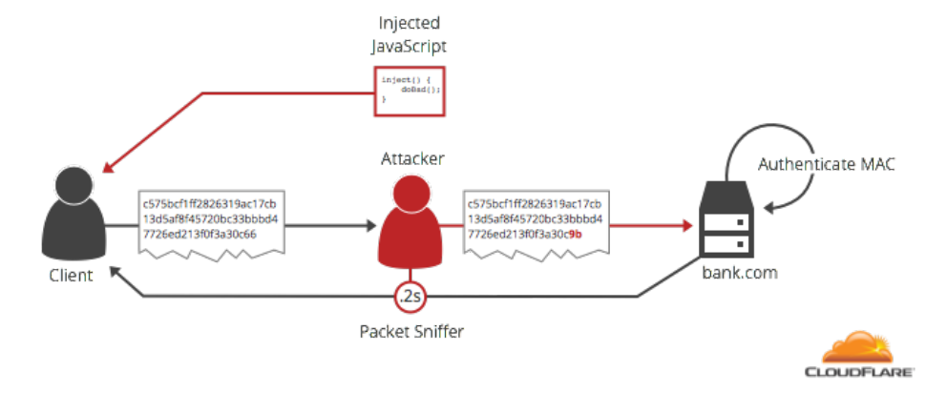
POODLE attack #2
Three possible ways for the decrypted data look
Invalid padding
Valid padding, wrong HMAC
Valid padding, correct HMAC
From the second case, the attacker can assume the plaintext

Slide 57
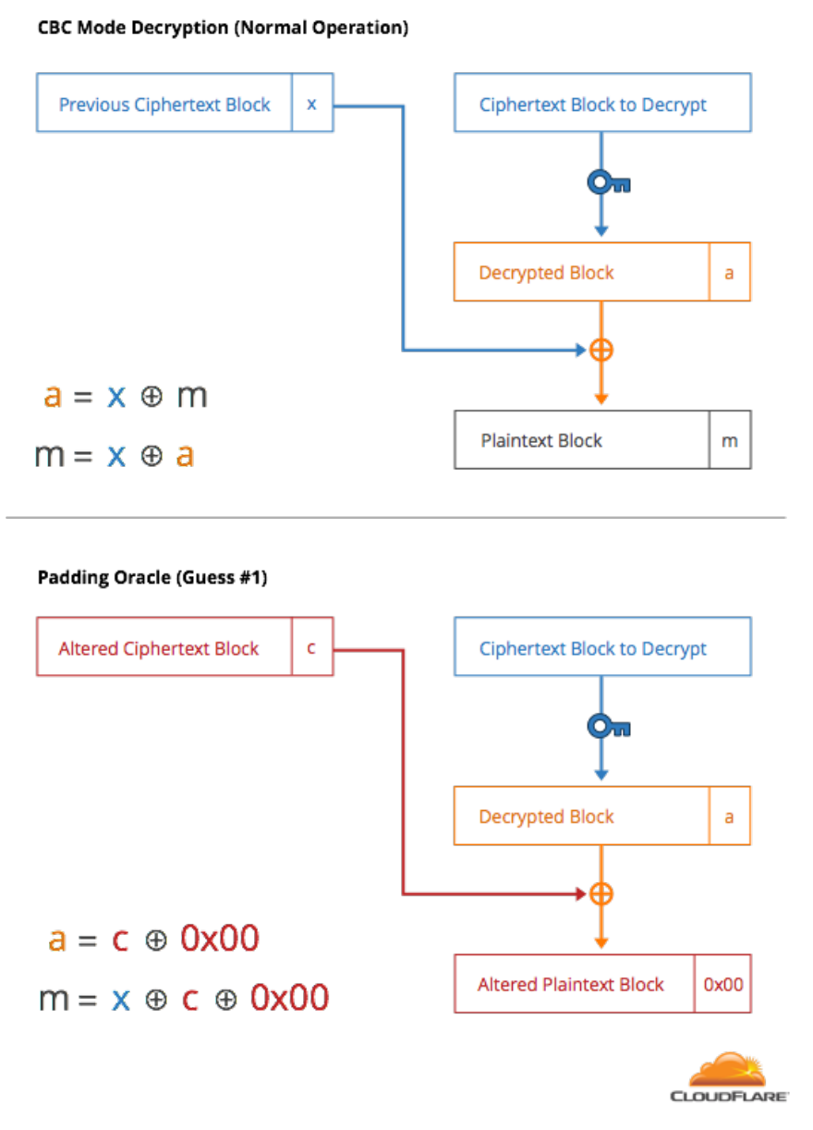
Poodle Attack #3
By changing bits of previous ciphertext block, second condition occur
Wrong HMAC and correct padding scenario make attacker possible to decrypted block
Can know full plaintext by adjusting padding bits

Slide 58
Authenticated Encryption with Associated Data
The combination of cipher and MAC
GCM was the representation of AEAD
Data is both authenticated and encrypted
AES-GCM/CCM Was explained on previous chapter
MAC code is calculated during encryption procedure
MAC code is authenticated during decryption procedure

Slide 59
Conclusion
Overview web security threats and Web traffic security approaches
Overview of Secure Sockets Layer (SSL)
Differences between Secure Sockets Layer and Transport Layer Security
Compare the pseudorandom function used in Transport Layer Security
Overview of HTTPS (HTTP over SSL)
Differences with TLS and TLS 1.3

